Slide 1
Mental health and alcohol use in young Australians during COVID-19
Philip Clare
Prevention Research Collaboration
© Philip Clare 2021
Notes:
Kamegal people of the Eora nation

Slide 2
Contents
APSALS Cohort
Background
This study
Results
Conclusions
Notes:
Missing not at random data is very difficult to deal with. This is primarily because the only way to know why data is missing is to know what data is missing. There are approaches that deal with data that is missing not at random. But they all involve assumptions characterising the mechanisms underlying the reasons for missingness.

Slide 3
1. APSALS Cohort

Slide 4
APSALS Cohort
Created by: Laura Vogl and Richard Mattick
CIs and AIs: Raimondo Bruno, Louisa Degenhardt, John Horwood, Delyse Hutchinson, Kypros Kypri, Richard Mattick, Nyanda McBride, Jim McCambridge, Jake Najman, Amy Peacock, Tim Slade, Monika Wadolowski, Alexandra Aiken, Philip Clare, Tim Dobbins
Current/Past NDARC team: Wing See Yuen, Clara de Torres, Emily Upton, Cooper Jackson, Brittany Corkish, Veronica Boland
Funding: ARC, Australian Rotary Health, FARE, NHMRC

Slide 5
APSALS Cohort
Longitudinal project assessing parental and other sources of supply
Controlling for the known predictors of adolescent drinking
1927 adolescent/parent dyads recruited in NSW, TAS, WA in September 2010
First captured in Grade 7 aged ~13 years
From 49 schools (government - 39%, independent - 49%, catholic - 12%)
Adolescent sex - 45% female
Assessed annually on-line or paper
Parents surveyed until Wave 5

Slide 6
2. Background

Slide 7
Background
Mixed hypotheses about impact on alcohol
Possible declines due to restrictions.
Possible increases due to financial/psychological distress, known risk factors of alcohol consumption
Concern about potential negative impacts on mental health
Cross-sectional studies show elevated depression, anxiety and stress amongst young adults during the pandemic
However, little longitudinal research, and most of it from the USA
Notes:
Cross-sectional evidence of decreases in consumption (Callinan et al.)
Evidence from Ritter et al. of heterogenous response – equal split of decrease, increase and stayed the same
[If want to expand on why concern about mental health of young adults in particular, could mention]
The majority of mental health disorders emerge before 26 years of age (McGorry & Goldstone, 2011)
social isolation and loneliness were common among young people prior to the pandemic (Lim, Eres, & Peck, 2019).
Young people have low engagement with mental health treatment (Gulliver, Griffiths, & Christensen, 2010; Wilson, 2010), and social distancing practices may be a further barrier (Power et al., 2020).
Young people may also disproportionately experience certain stressors associated with the pandemic (Furlong & Finnie, 2020; Power et al., 2020). For example, industries most likely to report reduced staff working hours (e.g., hospitality) are those where the majority of young people are employed often casually (ABS, 2020)

Slide 8
3. This study

Slide 9
This study
Extra survey conducted in mid 2020, in addition to the main APSALS study waves.

Slide 10
This study
All participants who had completed APSALS Wave 10 up to April 30 (n=813) and had providewere invited to participate
n=443 participants completed the COVID survey (54% response rate; 23% of the total sample).

Slide 11
This study

Slide 12
This study
Survey included a range of questions from the regular survey, adjusted to ‘past month’ rather than ‘past year’
Alcohol use
Alcohol-related harm
Mental Health
Use of mental health/addiction services
Also included questions about their experiences during the pandemic/lockdown
Notes:
Some measures in the regular survey were assessed annually – COVID survey was changed to monthly, with annual data pro-rated.
Alcohol use asked in all waves, but analysis limited to adult data.
Mental health questions added in wave 10, so analysis was more limited.
We also asked about perceived changes in alcohol use (e.g. ‘has your alcohol consumption changed since going into lockdown?”)
[Mental health – symptoms of depression (PHQ-9) and Generalised Anxiety Disorder (GAD-7)]

Slide 13
4. Results

Slide 14
Results – Sample
Mean age (SD) |  | 19.7 (0.5)
Gender | Male | 38.6%
 | Female | 61.4%
Income | $1-$12,999 | 46.6%
 | $13,000-$31,199 | 38.1%
 | $31,200-$67,599 | 14.0%
 | $67,600+ | 1.3%
SEIFA | Low | 13.8%
 | Medium | 21.3%
 | High | 64.9%
Family history of alcohol problems | No | 54.6%
 | Yes | 45.4%
Mean peer substance use (SD) |  | 14.4 (4.1)
Mean peer disapproval of substance use (SD) |  | 2.8 (1.8)

Slide 15
Results – Experience during restrictions
There was relatively little concern about the COVID-19 disease itself
17% of the sample said they were at least moderately worried about contracting the disease
This is perhaps unsurprising – at the time of the survey:
only 6% of the sample had been tested for COVID-19
only 1 respondent had received a positive COVID-19 test result, and had fully recovered.
Notes:
The lack of concern, while potentially positive for mental health and coping, has a big potential downside. 28% of the sample reported they had experienced symptoms that are common in COVID-19, but only 20% of those who had experienced symptoms got tested.

Slide 16
Results – Experience during restrictions
Secondary impacts of the pandemic were more common
74% reported they had been or were currently in voluntary isolation
The use of precautions were common
Use of hand sanitizer/increased hand washing | 88%
Social distancing | 83%
Avoiding public space (and events | 72%
Cancelling gatherings | 66%
Avoiding public transport | 54%
Studying from home | 53%
Wearing a mask | 17%
Notes:
At this point, the requirement to wear masks was not as widespread.

Slide 17
Results – Experience during restrictions
Housing difficulties were relatively rare
<5% had housing difficulties
10% of the sample had moved in with family or their partner
20% of the sample reported financial stress
Stood down temporarily or permanently from work | 28%
Reduced hours or income | 24%
Required to work remotely | 9%
Required to take paid leave | 3%
Required to take unpaid leave | 2%

Slide 18
Results – Alcohol consumption
Frequency of consumption
Typical quantity consumed

Slide 19
Results – Alcohol consumption
Binge Drinking
Overall consumption

Slide 20
Results – Alcohol consumption
Change in drinking context

Slide 21
Results – Alcohol-related harms
Alcohol related harms | February 2020 | May-June 2020
Total number of harms (mean/sd) | 0.70 (0.05) | 0.47 (0.04)
Reported any harms | 36.8% | 26.2%
Individual harms
Were sick after drinking | 16.0% | 10.8%
Had a hangover | 33.9% | 24.6%
Were unable to remember what happened | 13.1% | 7.4%
Got in a physical fight | 0.9% | 0.5%
Damaged something | 1.6% | 2.3%
Got into trouble with friends | 1.4% | 0.9%
Had sex that they later regretted | 2.9% | 0.5%
Had an accident, injury or fall | 1.8% | 1.6%

Slide 22
Results – Self-reported impact of COVID-19
Self-reported change in drinking since before the COVID-19 restrictions | %
Increased | 19.4%
Stayed the same | 57.0%
Decreased | 23.5%
Reasons for increased consumption (n=75)
More bored/less things to occupy time | 78.0%
More time to use alcohol | 55.7%
To cope with anxiety/stress of day-to-day activities (e.g. looking after children, work) | 40.2%
Greater anxiety/depression with COVID-19 | 37.0%
Larger amounts available on hand because I stocked up | 29.0%
To cope with loneliness | 26.3%
Reasons for decreased consumption (n=116)
Fewer opportunities to be with people / go out to drink | 91.2%
Didn't feel like using alcohol | 52.5%
Because of work/study commitments | 34.5%
Less money to spend on alcohol or saving money | 27.8%
Avoiding leaving home to obtain alcohol | 26.1%
Worried about effects on my mental health | 26.0%
Worried about effects on my physical health | 22.3%

Slide 23
Results – Mental health
PHQ-9 Score
GAD-7 Score

Slide 24
Results – Mental health
Likely Depressive Disorder (PHQ-9)
Likely GAD (GAD-7)
Notes:
Higher odds of meeting the clinical cut-off score for likely depressive disorder, with a third of the sample reporting symptoms at or above the cut-off score at May-June 2020. (No significant increase in the odds of meeting the clinical cut-off score for likely GAD).
- Participants’ retrospective self-ratings of their mental health appeared to align with this prospective change, with half of participants reporting their mental health had worsened since February.
- Just under half (44.9%) of participants rated their mental health as poor or fair at May-June 2020.

Slide 25
Results – Mental health
Help-seeking for mental health

Slide 26
Results – Self-help behaviours
 | %
Reminded self this period of restrictions is temporary | 66.9%
Tried to find reliable sources of information about COVID-19 (e.g., government websites) | 60.7%
Stayed connected with friends, family and colleagues via email, social media or phone | 82.6%
Engaged in healthy activities that you enjoy and find relaxing | 66.2%
Kept regular sleep routines | 43.4%
Tried to regularly get exercise | 69.2%
Avoided news and social media you find distressing | 47.1%
Sought support from friends and family when needed | 47.3%

Slide 27
4. Conclusions

Slide 28
Conclusions
Alcohol consumption declined, continuing a trend that began before the pandemic
This appeared driven by quantity, with no change in frequency of alcohol consumption, but declines in typical quantity consumed, and binge drinking
Unsurprisingly, there was a sharp decline in drinking with others in person, but this was large matched by increases in drinking with others virtually and drinking alone
There was a decline in the rate of alcohol-related harms
These may be related, as drinking at home is likely to reduce the risk of acute harms such as traffic accidents and fighting
Notes:
Baseline sample matched the Australian population in important ways:
Adolescent sample was 55.3% male versus 51.2% of the population (ABS, 2012)
80.4% of adolescents living in a two-parent household versus 80% of adolescents in general population (ABS, 2011)
Socioeconomic status (SES) index of the current sample is 1023.6 (SD=79.9) close to the Australian standardised mean SES index of 1000

Slide 29
Conclusions
Increases in depression and anxiety symptoms
Changes were less severe than in some other countries
Possibly due to the relatively low impact of COVID-19 in Australia
No change in help seeking
While the Australian Government introduced initiatives to improve access to mental health support, there may have been a lag in uptake, and barriers such as cost may have remained
Results for both alcohol and mental health were consistent by gender
Although women generally showed higher rates of depression/anxiety, there was no gender difference in change due to the restrictions
Notes:
Another potential barrier to help-seeking is longer than usual wait times for psychological services (Academic Unit of General Practice, 2020).
[Could say if you want] - We also found a high level of engagement in self-help behaviours such as getting regular exercise (69.2%), and reminding oneself this period of restrictions is temporary (66.9%).
It is possible that participants in this sample who experienced increased symptoms of depression and anxiety found self-help strategies sufficient in managing their mental health, negating the need for external professional support.

Slide 30
Strengths and Weaknesses
One of the few studies investigating impact of COVID-19 prospectively
Self-selected sample > but similar to population
Only covered relatively ‘early’ stages of the pandemic – May-June 2020
May not generalize beyond the Australian context
Mental health was self-report not clinical interview
Notes:
Only covered early stage – BUT APSALS is ongoing, so we will be able to follow-up with the sample to see how things have changed.
Baseline sample matched the Australian population in important ways:
Adolescent sample was 55.3% male versus 51.2% of the population (ABS, 2012)
80.4% of adolescents living in a two-parent household versus 80% of adolescents in general population (ABS, 2011)
Socioeconomic status (SES) index of the current sample is 1023.6 (SD=79.9) close to the Australian standardised mean SES index of 1000

Slide 31
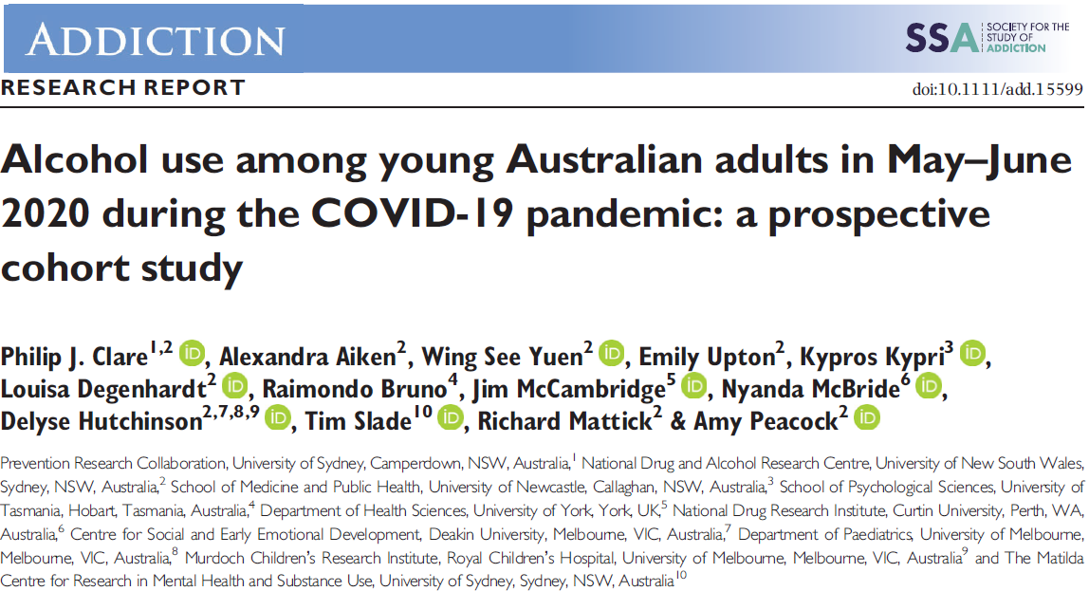
References

Slide 32
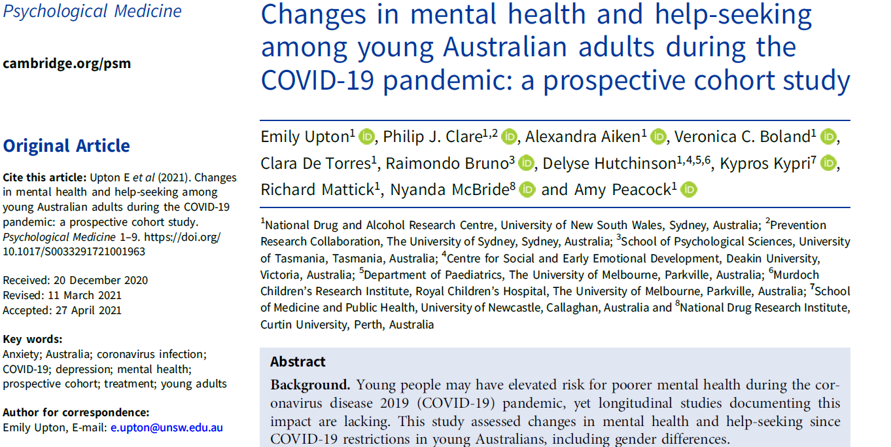
References

